Slide 1
AWS

Slide 2
Amazon Databases

Slide 3
Databases Intro
• Storing data on disk (EFS, EBS, EC2 Instance Store, S3) can have its limits
• Sometimes, you want to store data in a database…
• You can structure the data
• You build indexes to efficiently query / search through the data
• You define relationships between your datasets
• Databases are optimized for a purpose and come with different
features, shapes and constraints

Slide 4
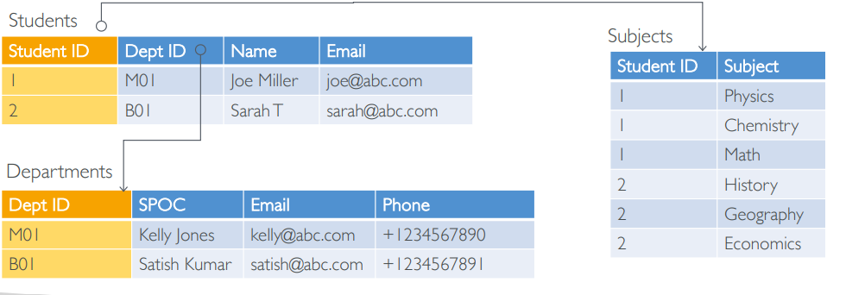
Relational Databases
• Looks just like Excel spreadsheets, with links between them!
• Can use the SQL language to perform queries / lookups

Slide 5
NoSQL Databases
• NoSQL = non-SQL = non relational databases
• NoSQL databases are purpose built for specific data models and have
flexible schemas for building modern applications.
• Benefits:
• Flexibility: easy to evolve data model
• Scalability: designed to scale-out by using distributed clusters
• High-performance: optimized for a specific data model
• Highly functional: types optimized for the data model
• Examples: Key-value, document, graph, in-memory, search databases

Slide 6
Amazon RDS Overview
• RDS stands for Relational Database Service
• It’s a managed DB service for DB use SQL as a query language.
• It allows you to create databases in the cloud that are managed by AWS
Postgres
MySQL
MariaDB
Oracle
Microsoft SQL Server
IBM DB2
Aurora (AWS Proprietary database)

Slide 7
Advantage over using RDS versus deploying DB on EC2
• RDS is a managed service:
• Automated provisioning, OS patching
• Continuous backups and restore to specific timestamp (Point in Time Restore)!
• Monitoring dashboards
• Read replicas for improved read performance
• Multi AZ setup for DR (Disaster Recovery)
• Maintenance windows for upgrades
• Scaling capability (vertical and horizontal)
• Storage backed by EBS
• BUT you can’t SSH into your instances

Slide 8
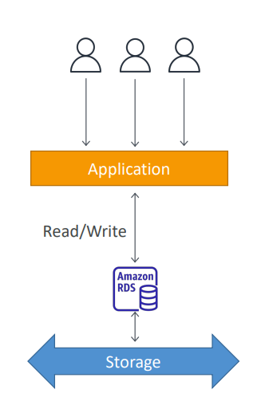
RDS – Storage Auto Scaling
• Helps you increase storage on your RDS DB instance dynamically
• When RDS detects you are running out of free database
storage, it scales automatically
• Avoid manually scaling your database storage
• You have to set Maximum Storage Threshold (maximum limit for DB storage)
• Automatically modify storage if:
• Free storage is less than 10% of allocated storage
• Low-storage lasts at least 5 minutes
• 6 hours have passed since last modification
• Useful for applications with unpredictable workloads
• Supports all RDS database engines

Slide 9
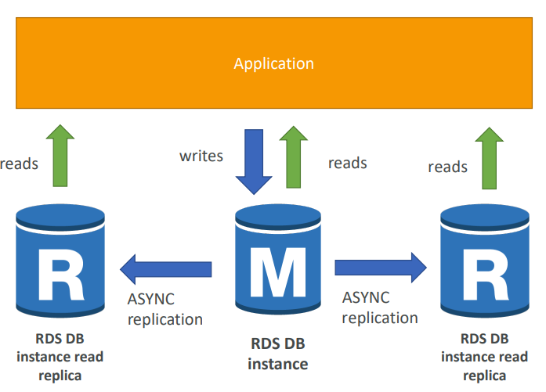
RDS Read Replicas for read scalability
Up to 15 Read Replicas
Within AZ, Cross AZ or Cross Region
Replication is ASYNC,
so reads are eventually consistent
Replicas can be promoted to their own DB
Applications must update the connection string to leverage read replicas

Slide 10
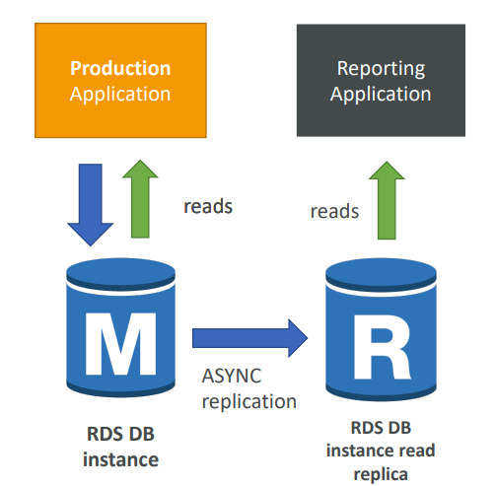
RDS Read Replicas – Use Cases
• You have a production database that is taking on normal load
• You want to run a reporting application to run some analytics
• You create a Read Replica to run the new workload there
• The production application is unaffected
• Read replicas are used for SELECT
(=read) only kind of statements
(not INSERT, UPDATE, DELETE)

Slide 11
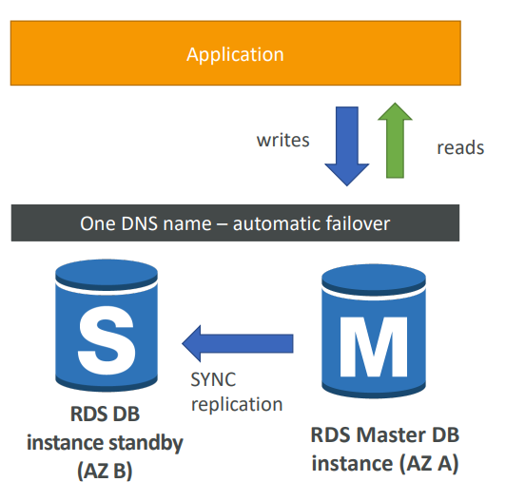
RDS Multi AZ (Disaster Recovery) • SYNC replication
• One DNS name – automatic app
failover to standby
• Increase availability
• Failover in case of loss of AZ, loss of
network, instance or storage failure
• No manual intervention in apps
• Not used for scaling

Slide 12
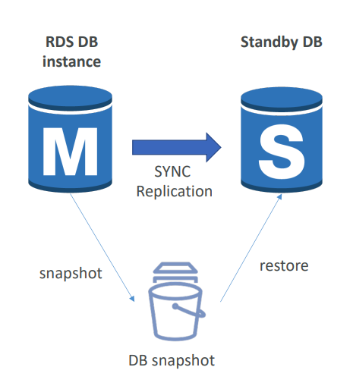
RDS – From Single-AZ to Multi-AZ
• Zero downtime operation (no need to stop the DB)
• Just click on “modify” for the database
• The following happens internally:
• A snapshot is taken
• A new DB is restored from the snapshot in a new AZ
• Synchronization is established between the two databases

Slide 13
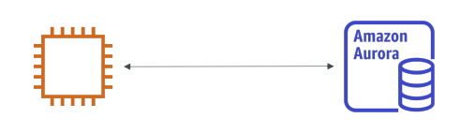
Amazon Aurora
• Aurora is a proprietary technology from AWS (not open sourced)
• PostgreSQL and MySQL are both supported as Aurora DB
• Aurora is “AWS cloud optimized” and claims 5x performance improvement
over MySQL on RDS, over 3x the performance of Postgres on RDS
• Aurora storage automatically grows in increments of 10GB, up to 128 TB
• Aurora costs more than RDS (20% more) – but is more efficient
• Not in the free tier

Slide 14
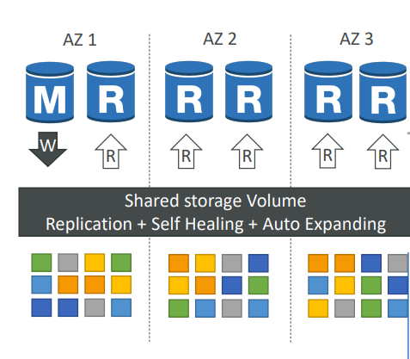
Aurora High Availability and Read Scaling
• 6 copies of your data across 3 AZ:
• 4 copies out of 6 needed for writes
• 3 copies out of 6 need for reads
• Self healing with peer-to-peer replication
• Storage is striped across 100s of volumes
• One Aurora Instance takes writes (master)
• Automated failover for master in less than
30 seconds
• Master + up to 15 Aurora Read Replicas
serve reads
• Support for Cross Region Replication

Slide 15
Features of Aurora
• Automatic fail-over
• Backup and Recovery
• Isolation and security
• Industry compliance
• Automated Patching with Zero Downtime
• Advanced Monitoring
• Routine Maintenance
• Backtrack: restore data at any point of time without using backups

Slide 16
RDS Backups
• Automated backups:
Daily full backup of the database (during the backup window)
Transaction logs are backed-up by RDS every 5 minutes
=> ability to restore to any point in time (from oldest backup to 5 minutes ago)
1 to 35 days of retention, set 0 to disable automated backups
• Manual DB Snapshots
Manually triggered by the user
Retention of backup for as long as you want

Slide 17
Aurora Backups
• Automated backups
1 to 35 days (cannot be disabled)
point-in-time recovery in that timeframe
• Manual DB Snapshots • Manually triggered by the user • Retention of backup for as long as you want

Slide 18
RDS & Aurora Security
• At-rest encryption:
Database master & replicas encryption using AWS KMS – must be defined as launch time
If the master is not encrypted, the read replicas cannot be encrypted
To encrypt an un-encrypted database, go through a DB snapshot & restore as encrypted
• In-flight encryption: TLS-ready by default, use the AWS TLS root certificates client-side
• IAM Authentication: IAM roles to connect to your database (instead of username/pw)
• Security Groups: Control Network access to your RDS / Aurora DB
• No SSH available
• Audit Logs can be enabled and sent to CloudWatch Logs for longer retention

Slide 19
Amazon RDS – Summary
• Managed PostgreSQL / MySQL / Oracle / SQL Server / DB2 / MariaDB
• Provisioned RDS Instance Size and EBS Volume Type & Size
• Auto-scaling capability for Storage
• Support for Read Replicas and Multi AZ
• Security through IAM, Security Groups, KMS , SSL in transit
• Automated Backup with Point in time restore feature (up to 35 days)
• Manual DB Snapshot for longer-term recovery
• Managed and Scheduled maintenance (with downtime)
• Support for IAM Authentication, integration with Secrets Manager
• Use case: Store relational datasets (RDBMS / OLTP), perform SQL queries, transactions

Slide 20
Amazon DynamoDB
• Fully managed, highly available with replication across multiple AZs
• NoSQL database - not a relational database
• Scales to massive workloads, distributed database “serverless” database
• Millions of requests per seconds, trillions of row, 100s of TB of storage
• Fast and consistent in performance
• Single-digit millisecond latency – low latency retrieval
• Integrated with IAM for security, authorization and administration
• Low cost and auto-scaling capabilities
• No maintenance or patching, always available

Slide 21
DynamoDB – Basics
• DynamoDB is made of Tables
• Each table has a Primary Key (must be decided at creation time)
• Each table can have an infinite number of items (= rows)
• Each item has attributes (can be added over time – can be null)
• Maximum size of an item is 400KB
• Data types supported are:
Scalar Types – String, Number, Binary, Boolean, Null
Document Types – List, Map
Set Types – String Set, Number Set, Binary Set

Slide 22
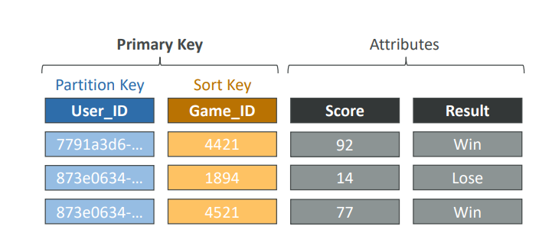
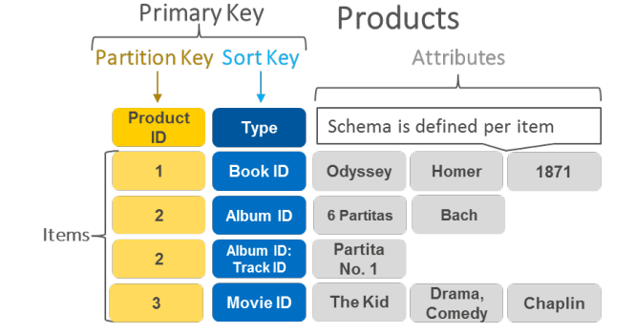
DynamoDB –Table example

Slide 23
DynamoDB – Read/Write Capacity Modes
• Control how you manage your table’s capacity (read/write throughput)
• Provisioned Mode (default)
You specify the number of reads/writes per second
You need to plan capacity beforehand
Pay for provisioned Read Capacity Units (RCU) & Write Capacity Units (WCU)
Possibility to add auto-scaling mode for RCU & WCU
• On-Demand Mode
Read/writes automatically scale up/down with your workloads
No capacity planning needed
Pay for what you use, more expensive ($$$)
Great for unpredictable workloads, steep sudden spikes

Slide 24
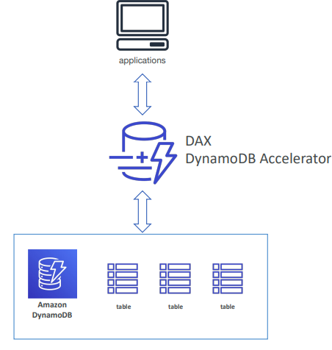
DynamoDB Accelerator – DAX
• Fully Managed in-memory cache for DynamoDB
• 10x performance improvement – single-
digit millisecond latency to microseconds
latency – when accessing your DynamoDB tables
• Secure, highly scalable & highly available
• Difference with ElastiCache :
DAX is only used for and is
integrated with DynamoDB, while
ElastiCache can be used for other
databases

Slide 25
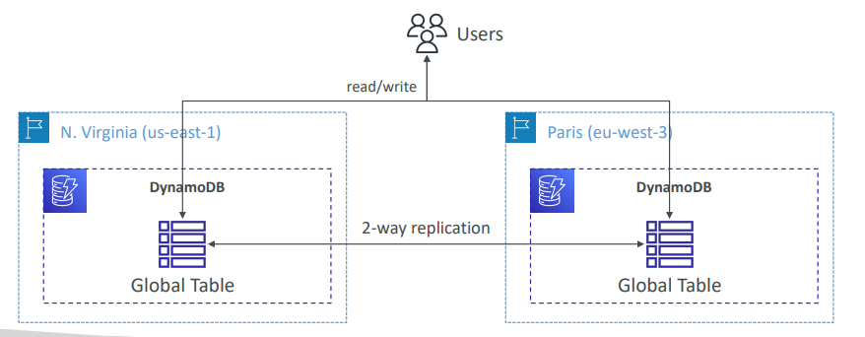
DynamoDB – Global Tables
• Make a DynamoDB table accessible with low latency in multiple-regions
• Active-Active replication
• Applications can READ and WRITE to the table in any region

Slide 26
DynamoDB – Backups for disaster recovery
• Continuous backups using point-in-time recovery (PITR)
Optionally enabled for the last 35 days
Point-in-time recovery to any time within the backup window
The recovery process creates a new table
• On-demand backups
Full backups for long-term retention, until explicitly deleted
Doesn’t affect performance or latency
Can be configured and managed in AWS Backup (enables cross-region copy)
The recovery process creates a new table

